Slide 1
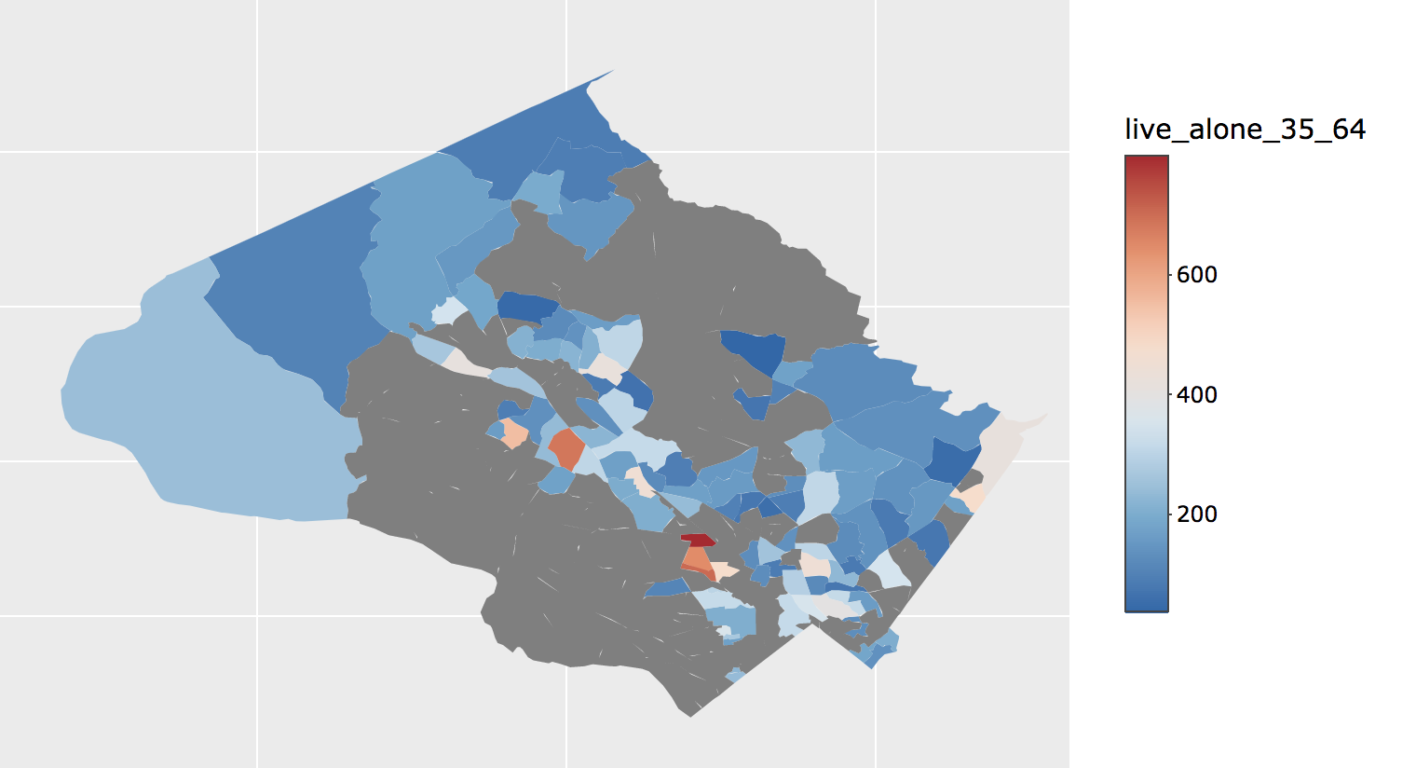
Relocating Young-Low-incomers To ADU’s
Target population: Young Low income renters (YLIR) in Montgomery County
The Problem:
YLIR represent 36% of relocators
Demonstrates lack of access to long-term affordable housing
The Approach:
Incentivizing middle-income home owners to build ADU’s
The Outcome:
Provides affordable housing
(60% of ADU’s are offered at below market rate)
Brings in additional household revenue for owners
Citations: Jumpstarting the Markets for ADUs
Middle Income 35-64 Yr Olds Living in Montgomery County in 2016
Map: Demonstrates tracts with most likely potential ADU home owners based on Portland case study.

